Slide 1


Can corruption be held responsible for deforestation?
By Aayushi Gupta

Slide 2
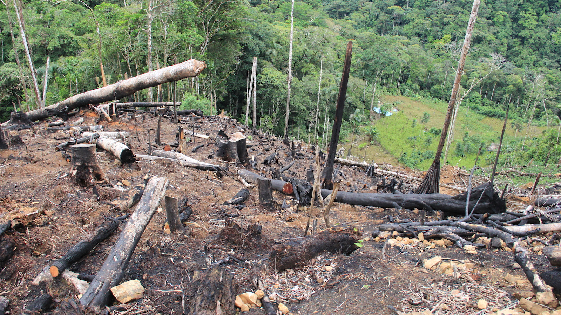
Why this topic?
Deforestation – loss of forest to agriculture, urban development, economic growth, and much more.
Result – climate change
Extremely vital to understand the causes of deforestation
Substitute of forests – Agriculture? => NO
There is no substitute of forests
Apart from the conversion for development purposes, what are the other causes? – CORRUPTION?

Slide 3
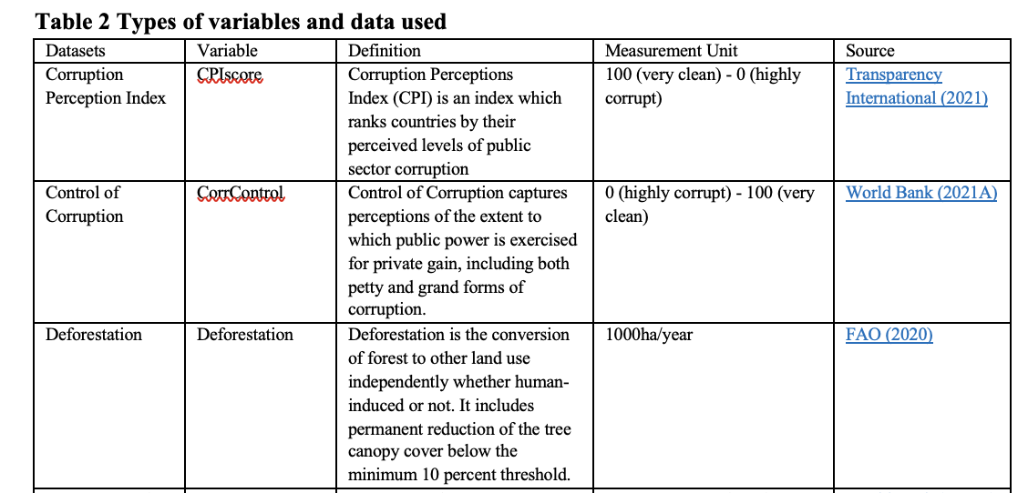
Main variables of the study
ln_CorrControl
ln_deforestation

Slide 4
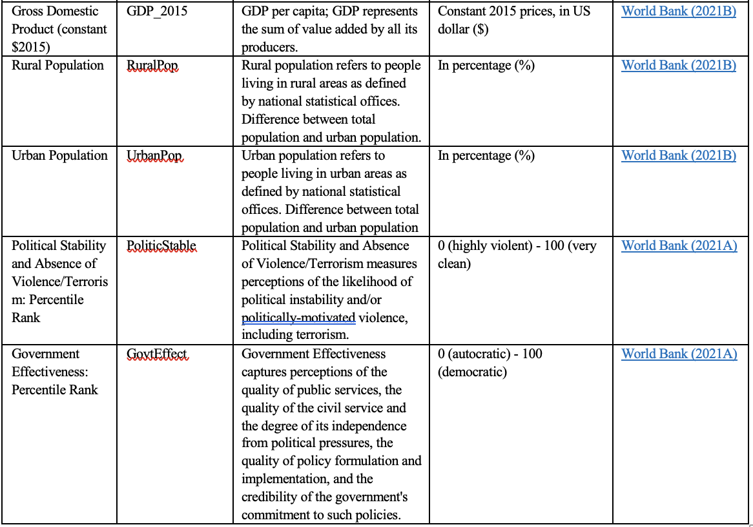
Covariates of the study

Slide 5
Methodology
Two hypothesis
Hypothesis 1:Increase in Corruption Perception Index decreases/increases deforestation
Hypothesis 2:Increase in control of corruption decreases/increases deforestation
Methods employed in the study are
1. Pooled data using OLS estimation
2. Entity fixed effects
3. Time fixed effects
4. Entity and time fixed effects

Slide 6
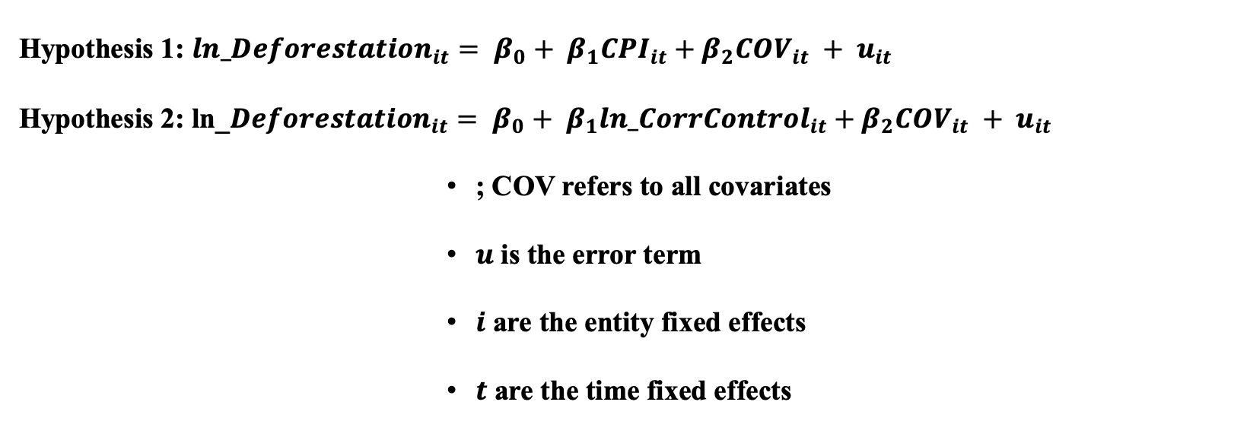
General model
Hypothesis 1: ${ln_Deforestation}_{it}= β_{0}+ β_{1}{CPI}_{it}+β_{2}{COV}_{it} + u_{it}$
Hypothesis 2: ln_${Deforestation}_{it}= β_{0}+ β_{1}{ln_CorrControl}_{it}+β_{2}{COV}_{it} + u_{it}$
; COV refers to all covariates
$u$ is the error term
$i$ are the entity fixed effects
$t$ are the time fixed effects

Slide 7
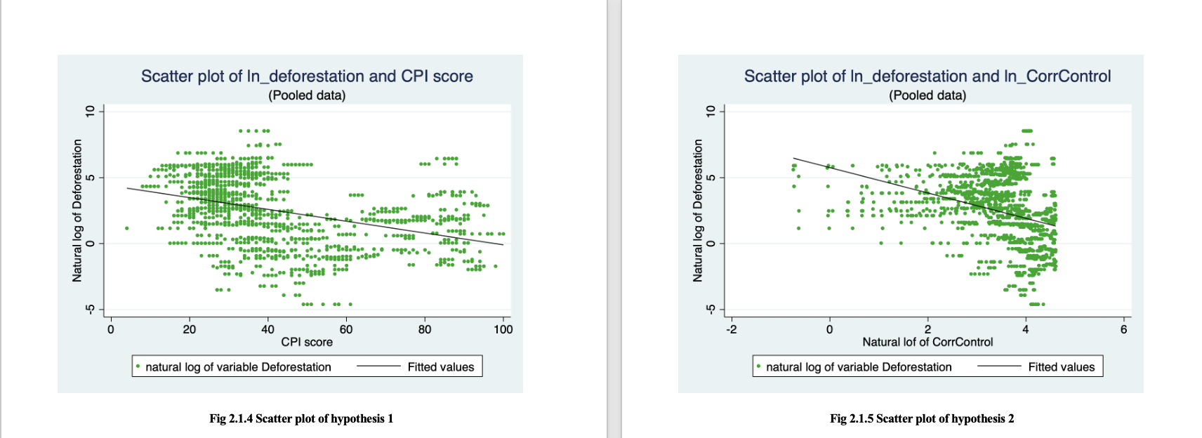
Graphic display of the relationship between main variables
A simple scatterplot displays a negative relationship between corruption and deforestation. However, this does not signify that decreasing corruption does lead to decreasing deforestation.

Slide 8
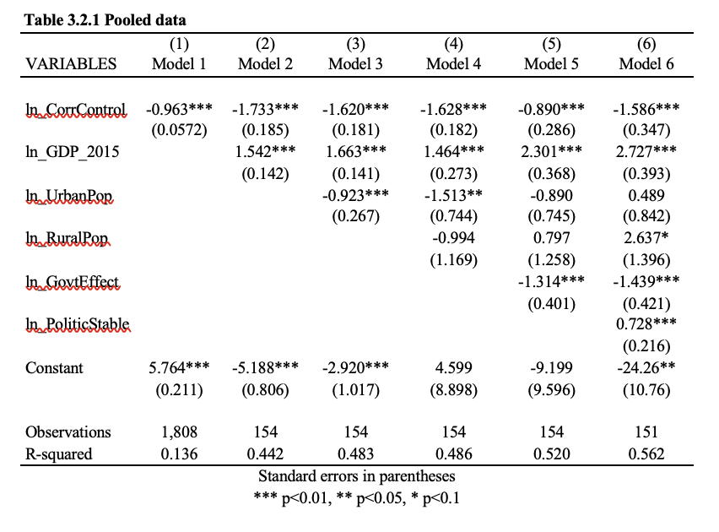
Results
The results obtained from entity fixed effects separately, and two-way fixed effects (results available in do file), were not statistically significant enough to be considered in the study – only pooled data and time fixed effects were considered.
Model 6:
ln_CorrControl by 1% deforestation by 1.58%
ln_GDP_2015 by 1% deforestation by 2.72%
ln_GovtEffect by 1% deforestation by 1.43%
ln_PoliticStable by 1% deforestation by 0.728%

Slide 9
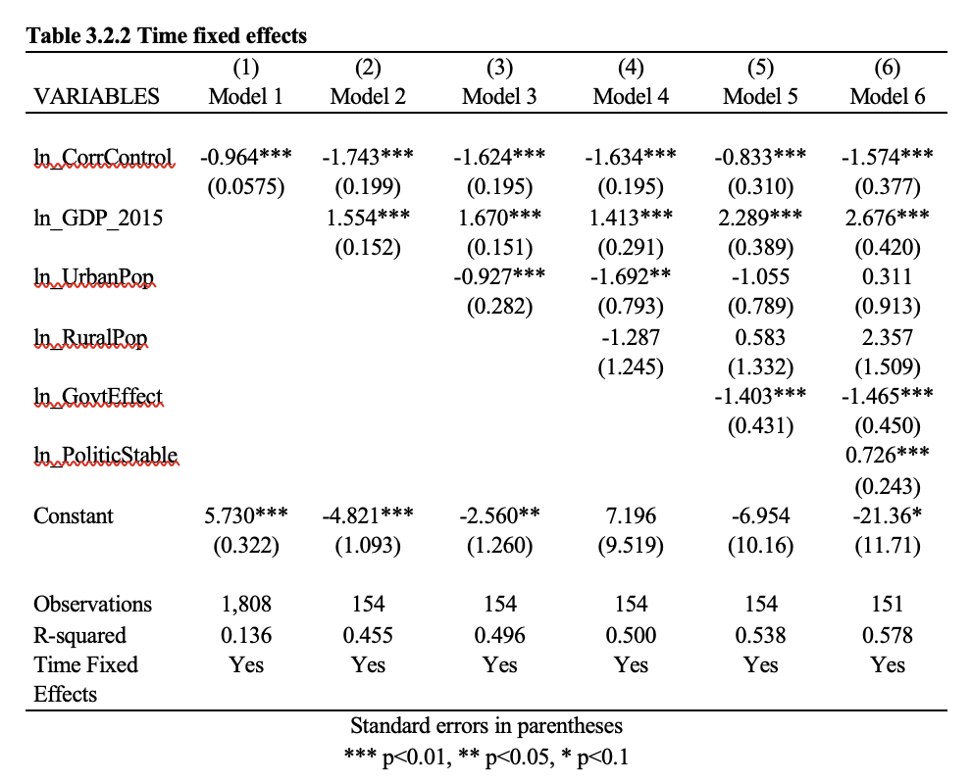

These models fix for any change over years, in the effect common to all countries. Therefore, they adjust for any unobserved omitted variables that are country invariant but changing over time.
Comparing the two tables: we observe the sign of $\hat{β_{1}}$to be the same for all models in both tables. However, the values of $\hat{β_{1}}$ in table 3.2.2, all models except Model 5 and 6, appear to be slightly smaller than the values of $\hat{β_{1}}$ in table 3.2.1 – Model 6 of previous table is slightly overestimated
Model 6:
ln_CorrControl by 1% deforestation by 1.574%

Slide 10
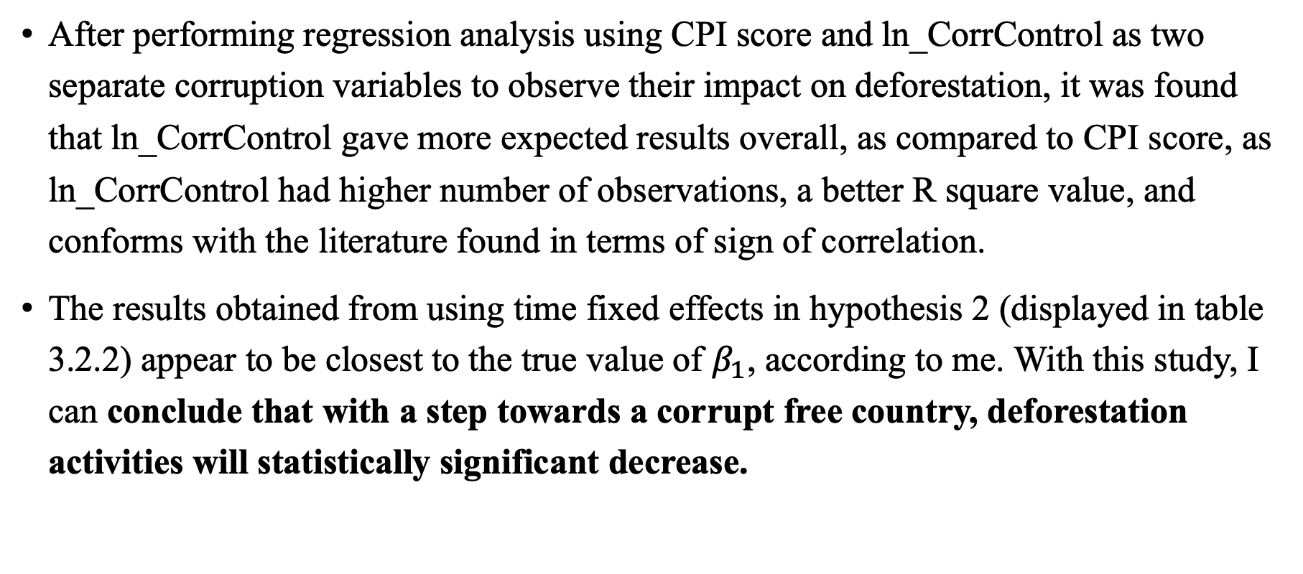
Conclusion
After performing regression analysis using CPI score and ln_CorrControl as two separate corruption variables to observe their impact on deforestation, it was found that ln_CorrControl gave more expected results overall, as compared to CPI score, as ln_CorrControl had higher number of observations, a better R square value, and conforms with the literature found in terms of sign of correlation.
The results obtained from using time fixed effects in hypothesis 2 (displayed in table 3.2.2) appear to be closest to the true value of $β_{1}$, according to me. With this study, I can conclude that with a step towards a corrupt free country, deforestation activities will statistically significant decrease.

Slide 11
Some limitations and future possibilities
CPI score is one of most profoundly used corruption indices. It is possible that my CPI score calculation before 2012 might not be as accurate as I used simple conversion formula to convert scores ranging from 1-10 to 1-100.
The corruption factor does not limit to corrupt practices being practiced in the forest. I believe, had I considered corruption variable that only relates to things like illegal logging, or bribery offered to forest officers, I might have got larger corruption coefficient values, signifying higher decline in deforestation.
After adding in control variables, the study’s sample size declined from ~1800 observations to merely ~150 observations.

Slide 12
Thank you!

